Slide 1
Power BI Architectural Designs
FSI CSU SWARM

Slide 2
Architectural Designs

Slide 3
Abstract and learning objectives
Understand the different types of Architectural Solutions are available for Power BI

Slide 4
Architecture Designs
Architecture Designs | This PowerPoint discusses Concepts and Terminologies relevant to Azure Power BI, the Evaluation Criteria for environment considerations, and sample Solution Architectures.

Slide 5
Concepts and Terminology

Slide 6
Concepts and Terminology
AAD - Azure Active Directory.
AAD application - An application identity in AAD. An AAD application is required for authentication.
SaaS application (software-as-a-service) - A system implemented by an enterprise or ISV that is usually an online service. Its also related software systems for serving multiple customer tenants (organizations). For this article, the SaaS application uses Power BI Embedded to serve analytics to its different tenants. Power BI Embedded can also work for all types of applications when they have an online connection.
Tenant – A single customer (organization) that uses the SaaS application and any resources or data that the customer brings to the SaaS application.
Power BI - The Power BI cloud service that serves as a platform for Power BI Embedded.
Power BI tenant - Is a set of Power BI resources associated with a single AAD tenant.
Power BI workspace - A container for content in Power BI.
Power BI artifacts – There are several Power BI artifacts in Power BI workspaces such as dashboards, reports, datasets, and dataflows.
Power BI Embedded - A set of public APIs that allow developers to build applications that manage Power BI content and embed Power BI elements.

Slide 7
Concepts and Terminology
Row-level security (RLS) - Gives the ability to control user access to the data for individual rows in a table. You can implement row-level security at the data source level or in the Power BI semantic model.
Master user - The identity that represents the SaaS application in Power BI and that the SaaS application uses when calling Power BI APIs. Needs to be an AAD user with a Power BI Pro license.
AAD Application user (service principal) - The identity that represents the SaaS application in Power BI and that the SaaS application uses when calling Power BI APIs. Needs to be an AAD web application. Can replace the use of a master user to authenticate with Power BI.
Capacity - A set of resources dedicated to running the Power BI service. Power BI Premium capacities Intended for enterprise companies using Power BI internally, while Power BI Embedded capacities intend for application developers to develop SaaS applications for third parties.
Power BI Pro license - A user-based license, which grants rights to publish content to app workspaces, consume apps without Premium capacity, share dashboards, and subscribe to dashboards and reports.
Data connectivity modes - Connecting data sources to Power BI that can be done in different modes:
Import - which is the most common way to get data.
DirectQuery - connect directly to the data in its source repository.
Live connection - another mode that connects directly to Analysis Services data (both Azure and on-premises).

Slide 8
Evaluation Criteria

Slide 9
Data architecture
Usually, developers building applications with Power BI Embedded already have a single or multi-tenant database. It's easier to use a tenancy model for Power BI Embedded which is similar to the tenancy model of the database. If the database tenancy model hasn’t been defined yet, you may want to consider other aspects before deciding on your data architecture.

Slide 10
Data Isolation
How sensitive is the data being stored? What level of isolation do you need separating different customer tenants? The answer might vary across different industries or specific customers that have certain requirements.

Slide 11
Scalability
To find the best solution, define the scale you reach in the foreseeable future. Remember that a solution that might be suitable now might not suffice when usage and data scale up. When analyzing scalability, consider the following list:
Number of tenants (customers).
Number of reports, dashboards, and datasets for each tenant.
Size of data on each dataset and frequency of refreshes.
Number of users.
Number of concurrent users in peak times.
Some SaaS applications might have a low number of customers and low usage, but large amounts of data. Others might have many customers and high usage, but a small amount of data and reports for each customer. High numbers in any of these situations can impact future costs and operational complexity.

Slide 12
Automation & operational complexity
Identify frequently occurring processes that need automation.
What is the frequency of onboarding new tenants? What actions are needed to fully onboard each one?
What is the release cadence for new or updated Power BI content, that needs to be deployed?
How many row-level security roles are defined for each tenant?
Identifying these processes and how you address them can help you understand the operational complexity involved in maintaining each model.

Slide 13
Data Residency Requirements
Power BI Embedded supports multi-geo deployment (preview feature). Multi-Geo enables Power BI Embedded resources to be deployed in different regions with specific content assigned to reside in specific regions.
This feature can be used across all models, but can have an impact on the amount of content to manage and cost. Currently multi-geo is designed for meeting data residency requirements and doesn't improve performance by moving data closer to consumers.

Slide 14
Cost
Power BI Embedded has a resource-based purchase model, like Power BI Premium. You purchase one or more capacities with fixed computing power and memory. This capacity is the main cost item when working with Power BI Embedded. There's no limit on the number of users using the capacity. The only limit is the performance of the capacity. A Power BI Pro license is required for each master user, or specific users that need to access the Power BI portal.
We recommend testing and measuring the expected load on your capacity by simulating live environment and usage and run load testing on the capacity. You can measure the load and performance with the various Metrics available in the Azure capacity or Premium capacity metrics app.

Slide 15
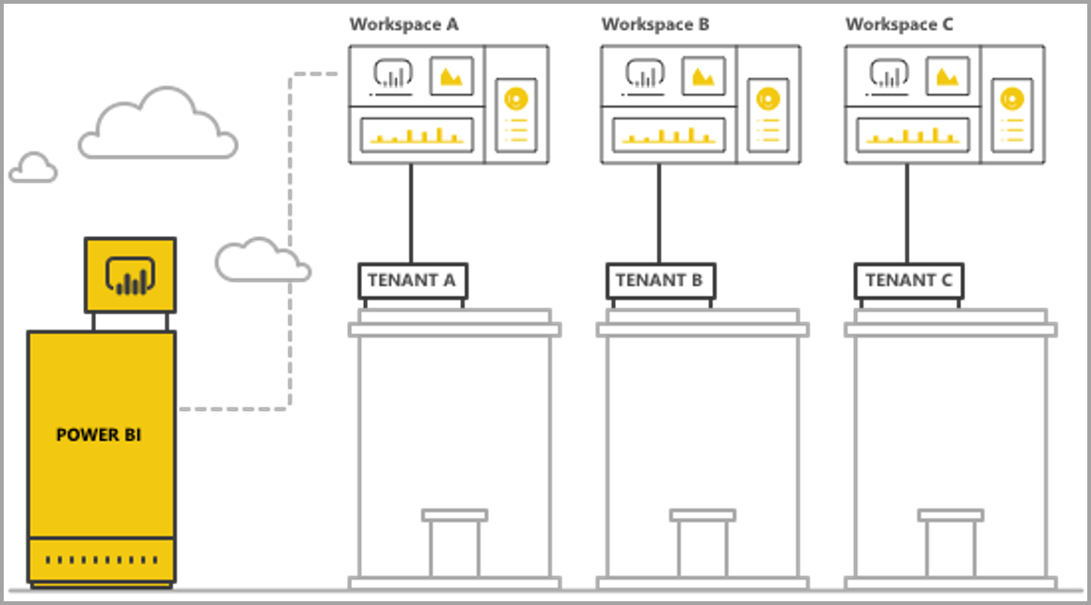
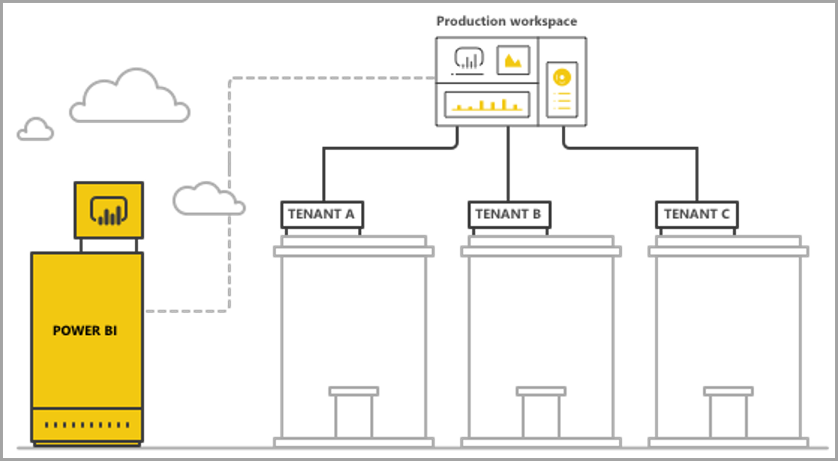
Workspace vs Row-Level Security Isolation
Click here to learn more about Power BI workspace-based isolation
With Power BI workspace-based isolation, the SaaS application supports multiple tenants from a single Power BI tenant. Workspace-based isolation contains all the Power BI content that different tenants use. The separation of tenants is done at the Power BI workspace level, by creating multiple workspaces.
Click here to learn more about Row-level security-based isolation
Implementing row-level security-based isolation is most comfortable when all tenants’ data is stored in a single data warehouse. In this case, the application developer can pass only the relevant data from the data warehouse into the Power BI dataset, either via Direct Query or data import. If data in the database is separated per tenant, it needs to be combined into a single dataset, which results in a lower degree of separation between tenants that existed in the database.

Slide 16
Summary Comparison
Evaluation Criteria | Workspace-based | Row-level security-based
Data architecture | Easiest when there's a separate database per tenant | Easiest when all the data for all tenants are in a single data warehouse
Data isolation | Good. Each tenant has a dedicated dataset. | Moderate. All data is in the same shared dataset but managed through access-control.
Scalability | Medium. Breaking the data into multiple datasets enables optimization. | Lowest. Constrained by dataset limits.
Multi-Geo needs | Good fit when most tenants are only in one region. | Not recommended. Needs to keep the entire dataset stored in multiple regions.
Automation & operational complexity | Good automation for the individual tenant. Complex to manage many artifacts at scale. | Easy to manage Power BI artifacts but complex to manage RLS at scale.
Cost | Low-medium. Can optimize utilization to reduce cost-per-tenant. Might increase when frequent refreshes are needed. | Medium- high if using Import mode. Low- medium if using Direct Query mode.
Content customization and authoring | Good fit. Might hit limitations at large scale. | Content generation in embedded iFrame only

Slide 17
Power BI Artifact limits
The number of workspaces V1 (groups) that a single user/application can be a member/admin of is 250.
The number of workspaces V2 (folders) that a single user/application can be a member/admin of is 1000.
The number of datasets in a single workspace is 1000.
The number of reports/dashboards connected to a single dataset is 1000.
THe dataset memory size limit to upload a .pbix file is 10 GB.

Slide 18
Power BI Capacity considerations and limitations
Each capacity can only use its allocated memory and V-cores, according to the SKU purchased.
For the recommended dataset size for each SKU, reference Premium large datasets.
The max dataset size in a dedicated capacity is 10 GB.
The number of scheduled refreshes for an import mode dataset in a day is 48.
The time between scheduled refreshes for an import mode dataset is 30 minutes.
For the number of refreshes that can run concurrently on a capacity, reference resource management and optimization.
The average time of scaling a capacity is between 1-2 minutes. During that time, the capacity isn't available. We recommend using a scale-out approach to avoid downtime.

Slide 19
Solution Architectures

Slide 20
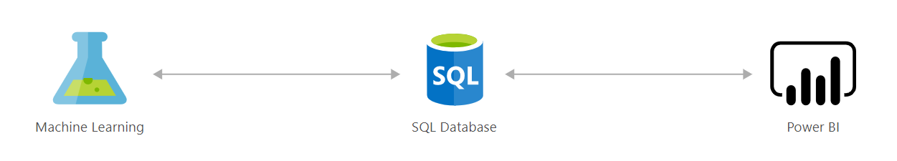
Loan credit risk analyzer and default modeling
Scoring credit risk is a complex process. Lenders carefully weigh a variety of quantitative indicators to determine the probability of default and approve the best candidates based on the information available to them.
This solution acts as a credit-risk analyzer, helping you score credit risk and manage exposure using advanced analytics models. SQL Server 2016 with R Services equips you with predictive analytics that help assess credit or loan applications and accept only those that fall above certain criteria. For example, you might use the predicted scores to help determine whether to grant a loan, then easily visualize the guidance in a Power BI Dashboard.
Data-driven credit-risk modeling reduces the number of loans offered to borrowers who are likely to default, increasing the profitability of your loan portfolio.

Slide 21
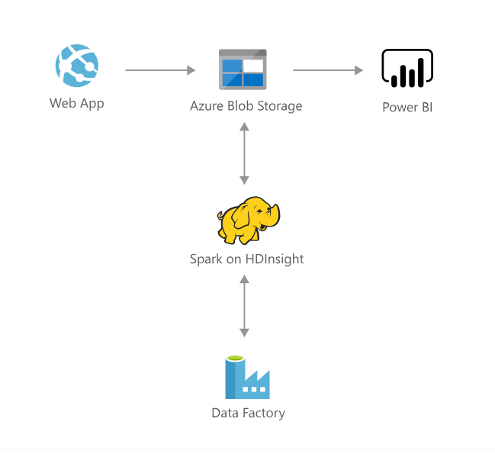
Demand Forecasting and Price Optimization
Pricing is recognized as a pivotal determinant of success in many industries and can be one of the most challenging tasks. Companies often struggle with several aspects of the pricing process, including accurately forecasting the financial impact of potential tactics, taking reasonable consideration of core business constraints, and fairly validating the executed pricing decisions. Expanding product offerings add further computational requirements to make real-time pricing decisions, compounding the difficulty of this already overwhelming task.
This solution addresses the challenges raised above by utilizing historical transaction data to train a demand forecasting model. Pricing of products in a competing group is also incorporated to predict cross-product impacts such as cannibalization. A price optimization algorithm then employs the model to forecast demand at various candidate price points and takes into account business constraints to maximize profit. The solution can be customized to analyze various pricing scenarios as long as the general data science approach remains similar.
The process described above is operationalized and deployed in the Cortana Intelligence Suite. This solution will enable companies to ingest historical transaction data, predict future demand, and obtain optimal pricing recommendations on a regular basis. As a result, the solution drives opportunities for improved profitability and reductions in time and effort allocated to pricing tasks.

Slide 22
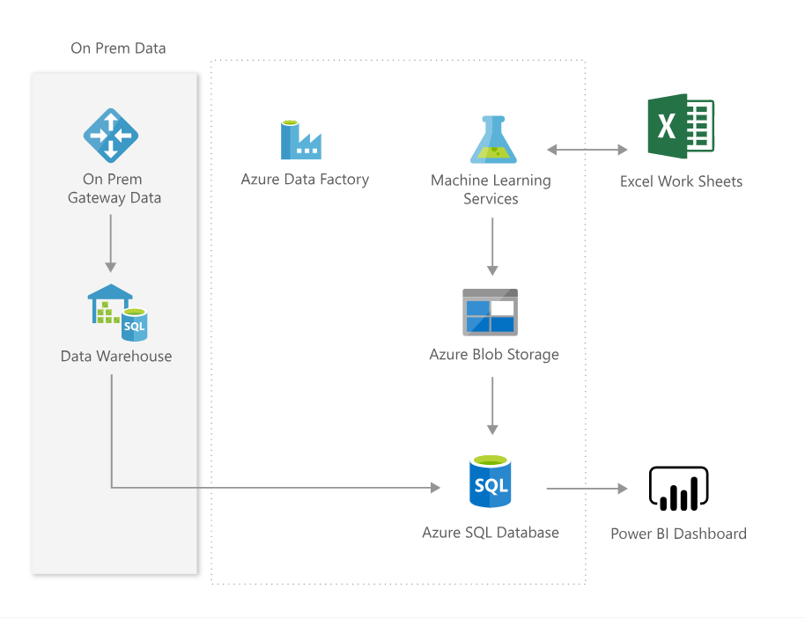
Interactive Price Analytics
The Pricing Analytics solution uses your transactional history data to show you how the demand for your products responds to the prices you offer, to recommend pricing changes, and allow you to simulate how changes in price would affect your demand, at a fine granularity.
The solution provides a dashboard, where you can see optimal pricing recommendations, item elasticities at a item-site-channel-segment level, estimates of related-product effects such "as cannibalization", forecasts given current process, and model performance metrics.
Direct interaction with the pricing model in Excel lets you simply paste your sales data there and analyze your prices without the need to integrate the data into the solution database first, simulate promotions and plot demand curves (showing demand response to price), and access dashboard data in numerical form.
The rich functionality is not confined to Excel. It is driven by web services that you, or your implementation partner, can call directly from your business applications, integrating price analysis into your business applications.

Slide 23
Wrap Up

